Slide 1

Linux Basics
&
Amazon Web Services
Presented By
KRS Srinivas
(MT-0874)
Instructed By
Mrs. Jyothsna

Slide 2

Linux
Operating System - Manages activities and resources of a computer.
software that acts as an interface between hardware and user.
provides a layer of abstraction for application developers.
Kernel - The lowest-level core of an operating system.
Linux - A kernel for a Unix-like operating system.

Slide 3
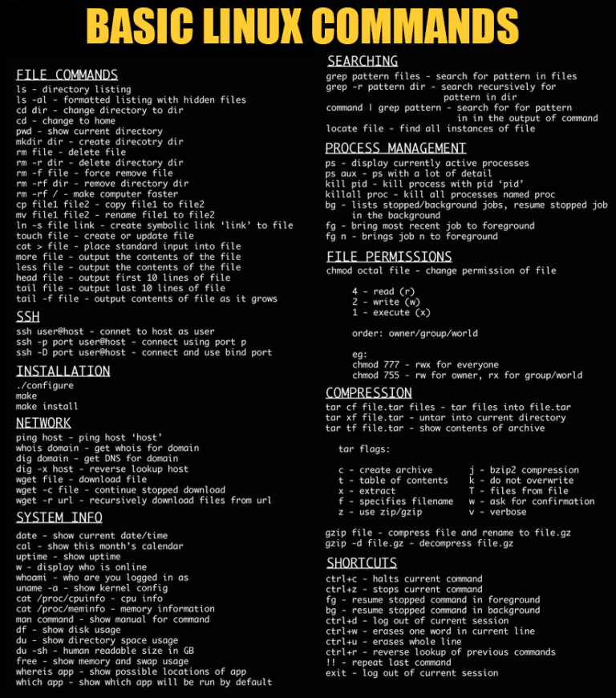
Linux Basic Commands

Slide 4
Linux Basic Commands

Slide 5

Cloud Computing....?
Using Someone’s Resources (On Demand) With Low cost (pay-as-you-go) and Reliable security available to you, with much greater effifciency than you could generate on your own.

Slide 6
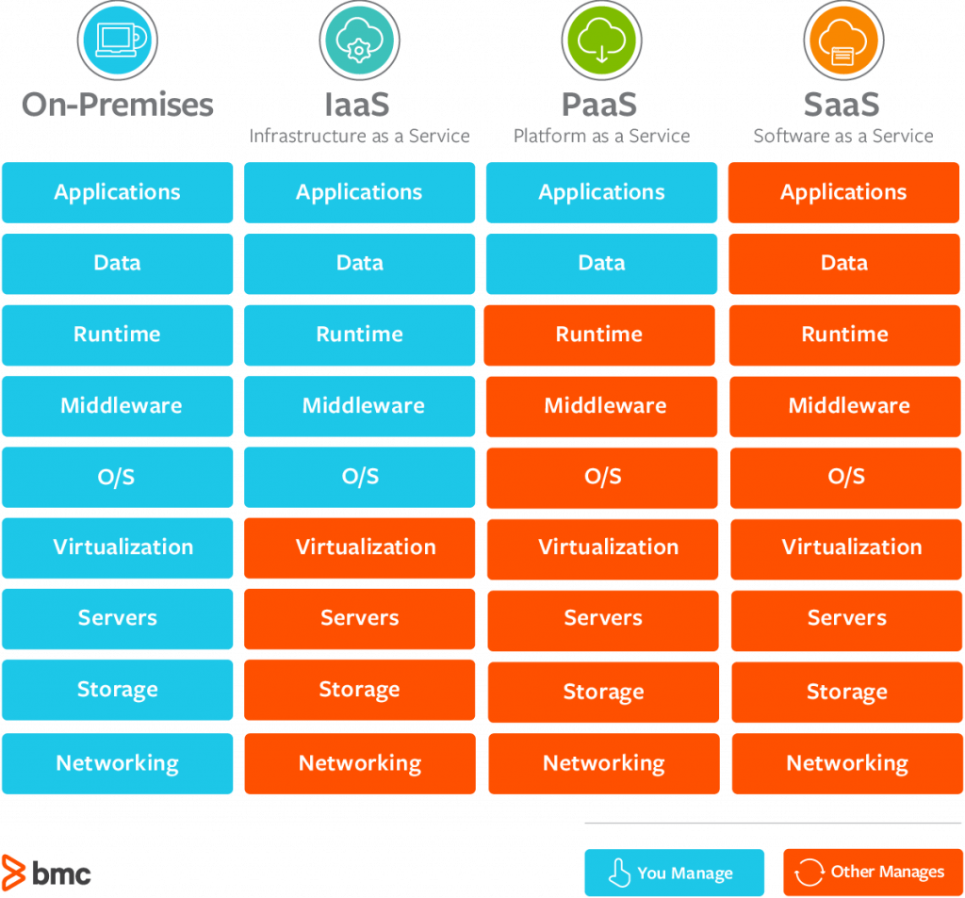
Types of Cloud Computing

Slide 7
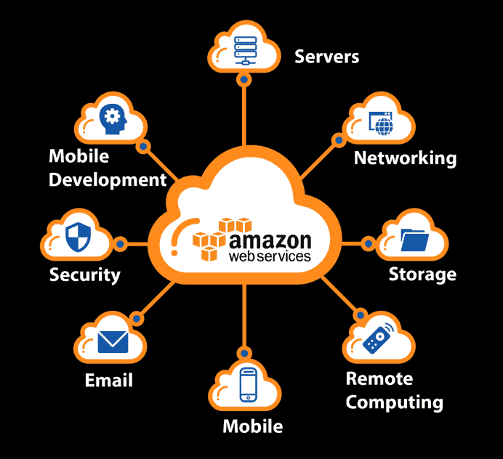
What is AWS....?
Amazon Web Services (AWS) is the world’s most comprehensive and broadly adopted cloud platform, offering over 200 fully-featured services from data centers globally.

Slide 8
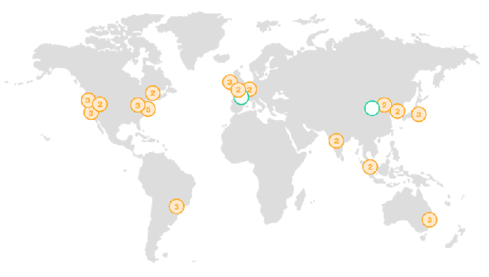
Global Infrastructure.....
Region - which is a physical location where they cluster Data Centers.
Availability Zone - Group of Logical Data Centers.
Edge Location - Where End users access services located at AWS.

Slide 9
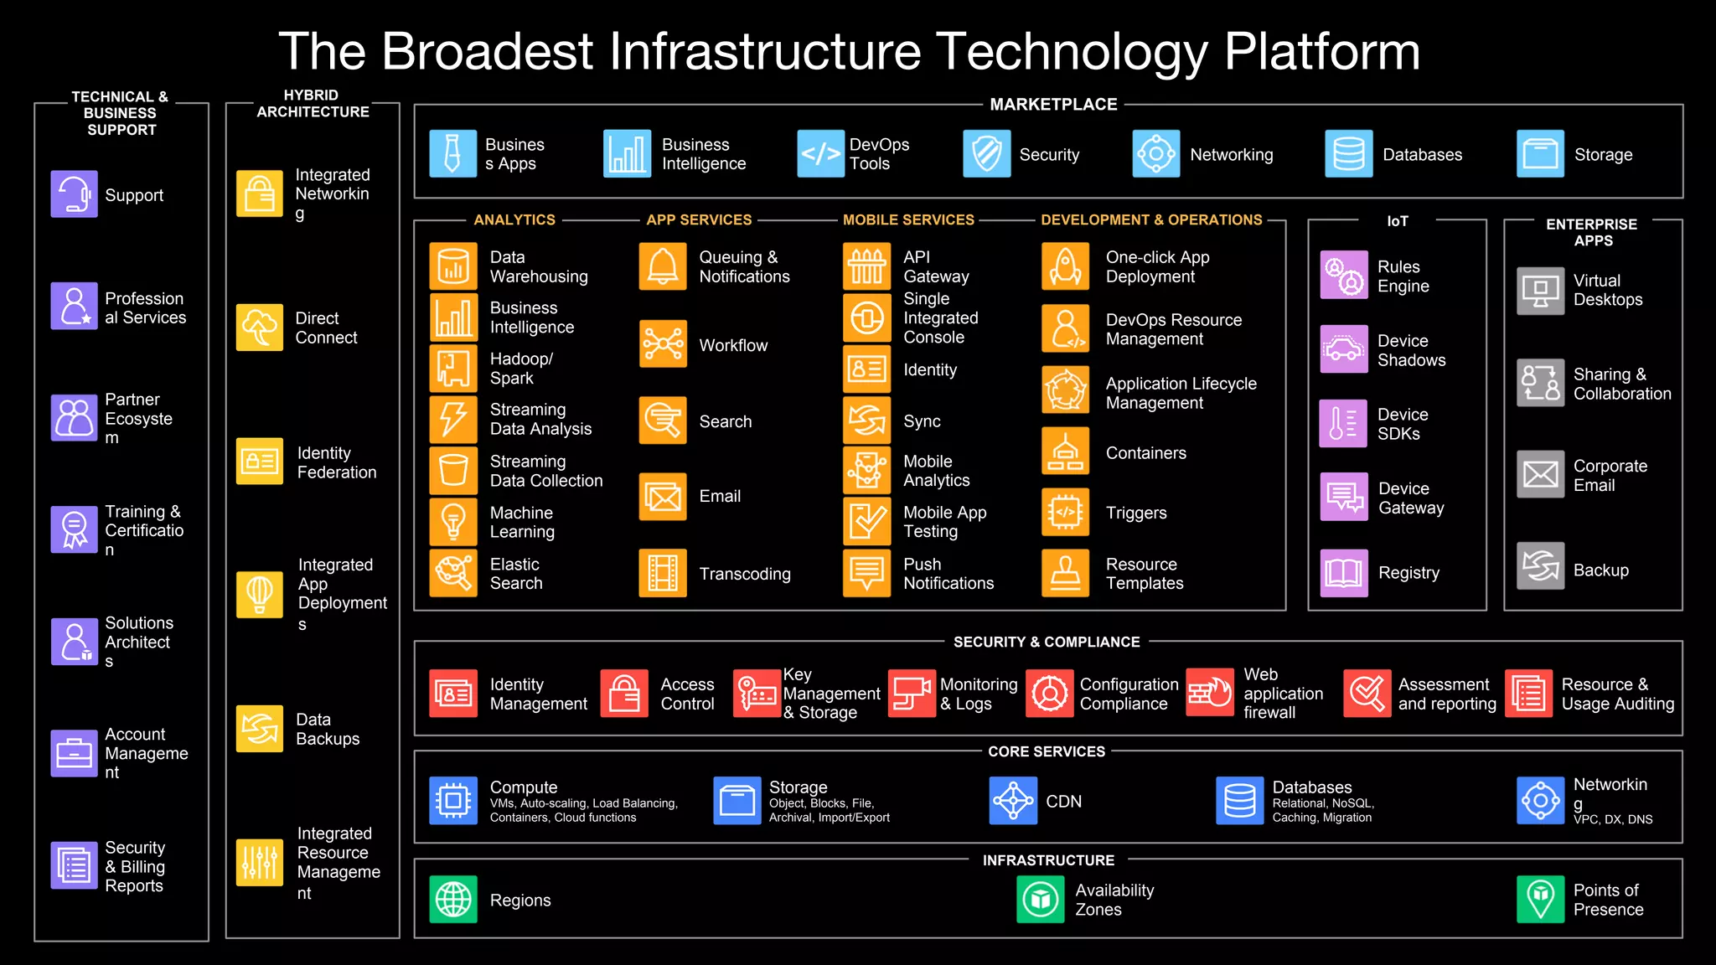
AWS - Services

Slide 10
AWS - Core Services
AWS - IAM
AWS - EC2
AWS - EBS
AWS - VPC
AWS - S3
AWS - CLOUDFRONT
AWS - CLOUDWATCH
AWS - SES
AWS - SNS
AWS - SQS

Slide 11

AWS - Core Services - IAM
IAM = Identity and Access Management, Global service.
Root account created by default, shouldn’t be used or shared.
Users are people within your organization, and can be grouped.
Groups only contain users, not other groups, with set of policies.
Users don’t have to belong to a group, and user can belong to multiple groups.
Who - Workforce users..
Can Access - Permission with IAM Policies..
What - Resources within the organization.

Slide 12
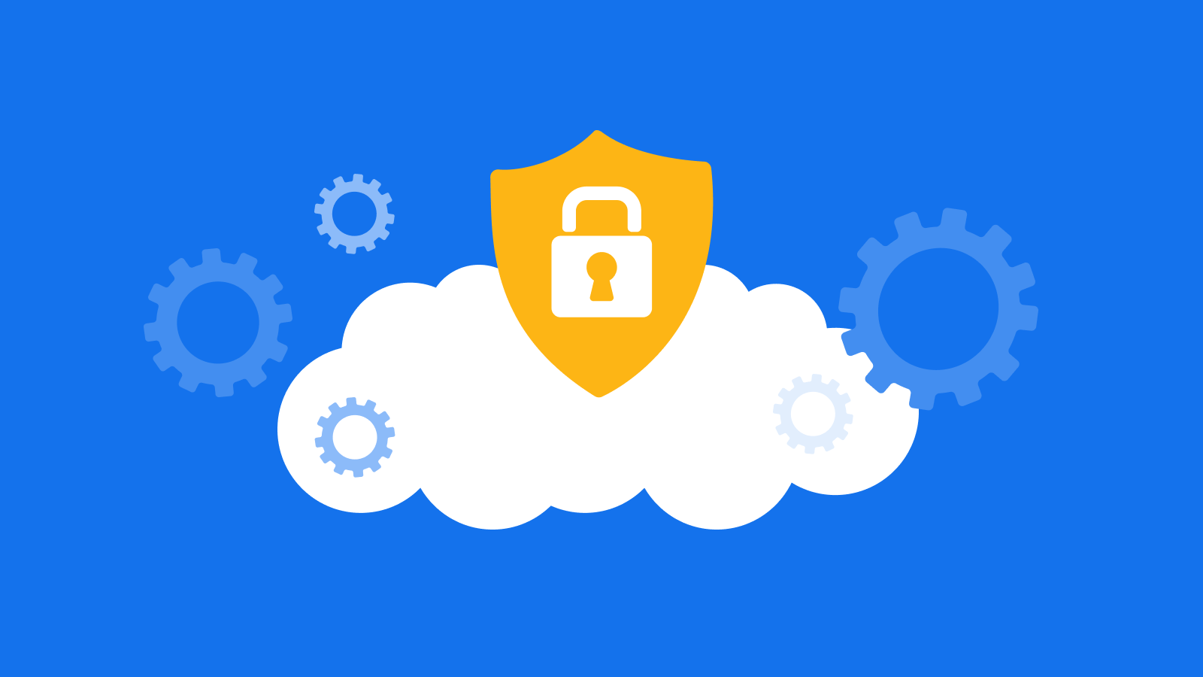
AWS - Core Services - VPC
Amazon Virtual Private Cloud (Amazon VPC) is a service that lets you launch AWS resources in a logically isolated virtual network that you define. You have complete control over your virtual networking environment, including selection of your own IP address range, creation of subnets, and configuration of route tables and network gateways.
Subnets - Group of IP Address range.
Route Table - Controls the routing policies to subnets.
Internet/Nat Gateways - Provides internet to subnets.
Elastic IP - Fixed IP until we release it.
Network ACL - Firewall allows/deny rules which are ordered via priority numbers.

Slide 13

AWS - Core Services - EC2
Amazon Elastic Compute Cloud (Amazon EC2) is a Regional web service that provides secure, resizable compute capacity in the cloud. It is designed to make web-scale cloud computing easier for developers
Instance Type & AMI - Instance Type and Size & OS required.
Storage/Volume - Selection of storage as per need EBS or S3.
Network & config - Config secure VPC and security settings.
Load Balancing - Enroutes the Traffic load to servers.
Autoscaling - Scales the servers based on Demand and load.

Slide 14

AWS - Core Services - EBS
An EBS (Elastic Block Store) Volume is a network drive you can attach to your instances while they run. It allows your instances to persist data, even after their termination. T They are bound to a specific availability zone.
EBS Snapshots - Make Backup of EBS at any point of time.
AMI - Customization of EC2 instance consisting own software, OS.

Slide 15

AWS - Core Services - S3
Amazon Simple Storage Service (Amazon S3) is an object storage service in the form of Buckets that offers industry-leading scalability, data availability, security, and performance. This means customers of all sizes and industries can use it to store and protect any amount of data for a range of use cases. Amazon S3 is designed for 99.999999999% (11 9's) of durability.
Storage Classes - Keeps the files in different storage classes.
Replication - Move/Copy files automatically by setting rules.
Versioning - Retrival of deleted files, Makes versions of altered files.
Transfer Acceleration - Accelerates the upload/Retrivals with high speed.
Static website Hosting - Hosts a website with the content.
Life Cycle - Creates life cycle of uploaded objects based on importance.

Slide 16
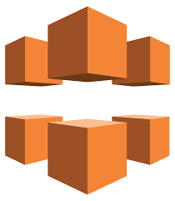
AWS - Core Services - Cloudfront
Amazon CloudFront is a fast content delivery network (CDN) service that securely delivers data, videos, applications, and APIs to customers globally with low latency, high transfer speeds, all within a developer-friendly environment.
Edge Location - This is the location where content will be catched.
Origin - This is the origin of all files that the CDN will distribute. This can be S3 Bucket.
Distribution - Collection of Edge Locations.

Slide 17
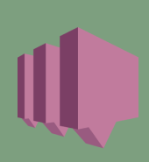
AWS - Core Services - SNS
Amazon SNS (Simple Storage Service) is a web service that makes it easy to send notifications from the cloud. It provides users with a hightly scalable, flexible and cost-effective capability to publish messages and immediately deliver them to subscribers.
Topic - It is an access point for allowing recipients to dynamically subscribe for identical copies of the same notification.
Inexpensive, Pay-as-you-go model.
All messages stored redundantly across multiple Availability Zones.

Slide 18

AWS - Core Services - SES
Amazon SES (Simple Email Service) is a email service designed to send and receive marketing, notifications and transactional emails to their customers using pay as you go model.
Automated emails.
Purchase confirmations, shipping notifications and order status updates.
Marketing communications, advertisements etc.
It is not subscription based.

Slide 19

AWS - Core Services - SQS
Amazon SQS (Simple Queue Service) is used to store messages while waiting for a computer to process them. It also acts as a temporary repository for messages that are awaiting for process.
It is pull based.
Messages can be kept in the queue for 14 days max.
SQS guaranteed that your messages will be processed at least once.

Slide 20

AWS - Core Services - CloudWatch
Amazon CloudWatch is a monitoring and observability service, CloudWatch collects monitoring and operational data in the form of logs, metrics, and events, providing you with a unified view of AWS resources, applications, and services that run on AWS and on_x0002_premises servers. You can use CloudWatch to detect anomalous behavior in your environments, set alarms, visualize logs and metrics side by side, take automated actions, troubleshoot issues, and discover insights to keep your applicatione,
Alarms - These are used to trigger notifications for any Metric.
CloudWatch Logs
Billing Alarms.
Can Create Dashboards.

Slide 21
?

